Slide 1

COST OF LIVING ANALYSIS
Name: Precious onyedeke
Batch: MIP-DA-08

Slide 2
Content
Q1 | Q2 | Q3 | Q4
What are the cities and countries with the highest and lowest costs of living? | What are the major cost components contributing to the overall cost of living in a region? | How do factors like average salary, housing costs, and transportation expenses correlate with the cost of living? | Conclusion

Slide 3


Report on the Cost of Living Data Analysis
215 countries and 4892 cities are included in the data, according to the repo

Slide 4
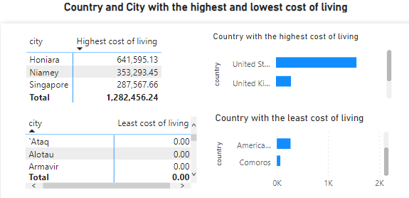
What are the cities and countries with the highest and lowest costs of living?
The United States of America and the United Kingdom have the highest cost of living, with 60,017,840.72 and 11,203,727.36 respectively.
Comoros has the lowest cost of living at 69.38, while American Samoa comes in second with 269.27.
For the city with the highest and least cost of living: Honiara with 641,595.13 and there are over 34 cities with 0 cost of living

Slide 5
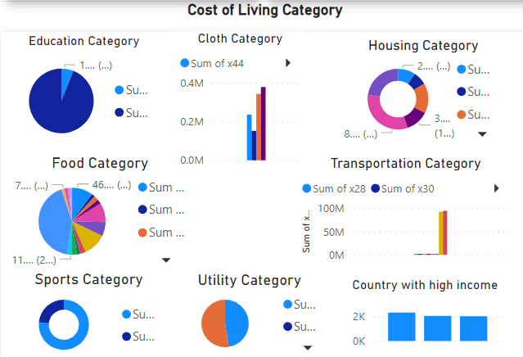
What are the major cost components contributing to the overall cost of living in a region?
The regions which displays high cost of living is Europe and North America
the components of cost of living is distributed into different categories, which includes:
Education: accounting for more than 98% of the total category costs, primary school education is the main expense component in this category.
Clothes: A Pair of Men's Leather Business Shoes, which cost more than $378,553.90, is the category's significant expense component.

Slide 6
What are the major cost components contributing to the overall cost of living in a region?
3. Housing: With 32% of the entire category, the Price per Square Meter to Purchase an Apartment in the City Center is the main cost factor.
4. Food: Meal for Two People, Mid-range Restaurant, Three-course: accounting for more than 42% of the total category costs, is the main cost component for this category.
5. Transportation: With a total cost of 94,582,707.14, the Toyota Corolla Sedan 1.6l 97kW Comfort (Or Equivalent New Car) is the category's largest cost component.

Slide 7
What are the major cost components contributing to the overall cost of living in a region?
6. Sports: the major cost component in this category is Fitness Club, Monthly Fee for 1 Adult which total cost is 131,959.83
7. Utility: the major cost component in this category is Internet (60 Mbps or More, Unlimited Data, Cable/ADS) which cost is 53.52% of the total cost

Slide 8
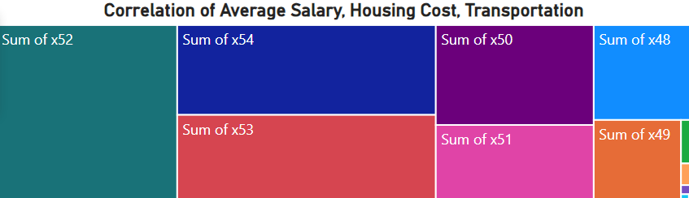
How do factors like average salary, housing costs, and transportation expenses correlate with the cost of living?
The average pay, housing costs, and transportation expenses were correlated, and the results of the Pearson correlation showed a non-significant medium positive link.

Slide 9
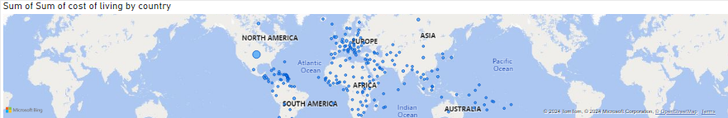
Conclusion
Based on the whole data, it can be shown that, for a variety of reasons, the United States and the United Kingdom have the highest costs of living.
It is more developed than other nations since there are many businesses and a large population in the cities. Because of the employment opportunities in these nations, people and companies frequently relocate there. Consequently, these nations have high living expenses. Additionally, research indicates that the average pay in the United States is higher than in any other state adjacent to the United Kingdom and Germany.

